Slide 1
Application of privacy and security in Deep learning
Patrick NONKI

Slide 2
Summary
Motivation
Types of attacks on security and privacy
Deep learning algorithms for defence in security and privacy

Slide 3
Motivation

Slide 4
Motivation
Sensitive data
A huge amount of data
Improve robustness of deep learning algorithms
Avoid integrity in applications such as Siri or Alexa

Slide 5
Types of attacks affecting security and privacy

Slide 6
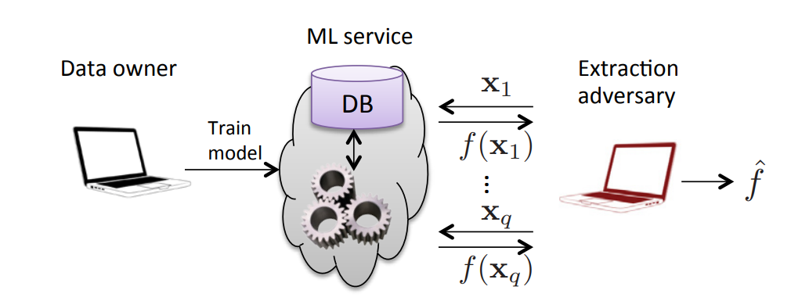
Types of attacks: Model extraction attack
The definition of model extraction attack is that an adversary can collect data through query access to a victim model and train a substitute model with it in order to steal the functionality of the target model
Query
Prediction
Extraction

Slide 7
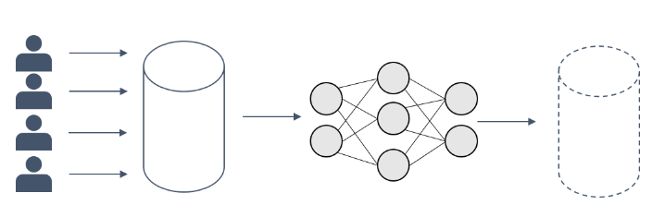
Types of attacks: Model inversion attack
The attack uses a trained classifier in order to extract representations of the training data

Slide 8
Types of attacks: Model inversion attack example
“The Secret Sharer : Measuring Unintended Neural Network Memorization & Extracting Secrets”, Carlini et al., 2018
• Step 1: Find some training text containing sensitive information (e.g. credit card numbers)
• “My credit card number is 3141-9265-3587-4001” ∈ Training text
• Step 2: Train your language model without really thinking too hard
• State-of-the-art log-likelihood!

Slide 9
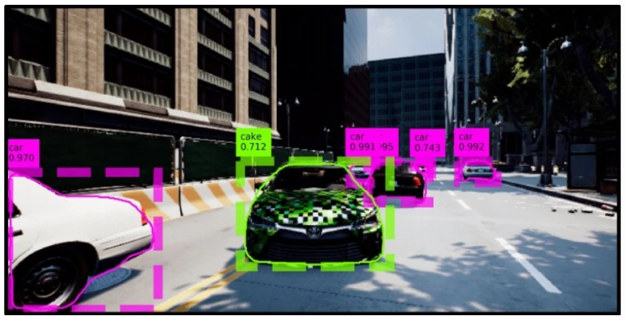
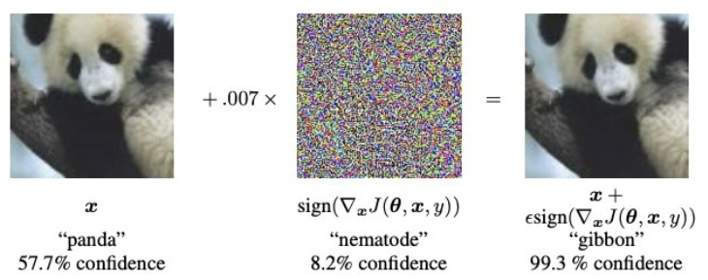
Types of attacks: Adversarial attack
An adversarial attack is a method to generate adversarial examples. Hence, an adversarial example is an input to a machine learning model that is purposely designed to cause a model to make a mistake in its predictions despite resembling a valid input to a human
A whitebox attack is a scenario where the attacker has complete access to the target model, including the model’s architecture and its parameters.
A blackbox attack is a scenario where an attacker has no access to the model and can only observe the outputs of the targeted model.

Slide 10
Deep learning algorithms of defence in security and privacy

Slide 11
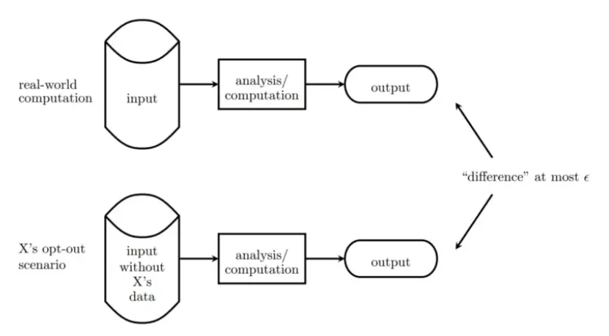
Differential privacy
Differential privacy (DP) is a strong, mathematical definition of privacy in the context of statistical and machine learning analysis.
This is done by adding random noise to the mechanism at work.
Gradient perturbation
Objective perturbation

Slide 12
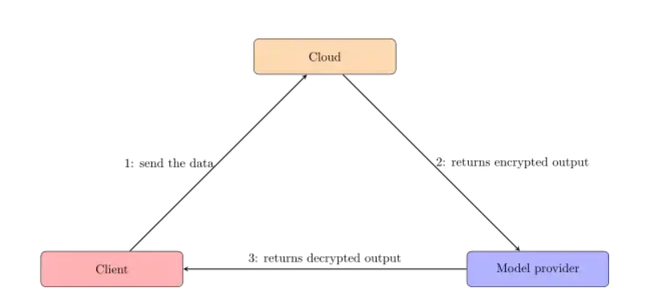
Homomorphic encryption
Homomorphic Encryption (HE) is a public key cryptographic scheme. The user creates a pair of secret and public key, uses the public one to encrypt her data, before sending it to a third party which will perform computations on the encrypted data.
The client sends her data unencrypted to the model hosted on the Cloud provider.
The Cloud host performs computation using the encrypted model, and the unencrypted data, then sends the result to the model provider.
The model provider decrypts the result, then sends it to the client.

Slide 13
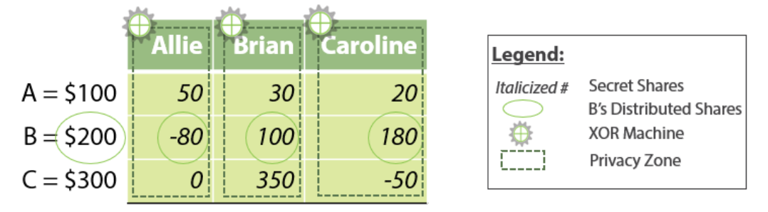
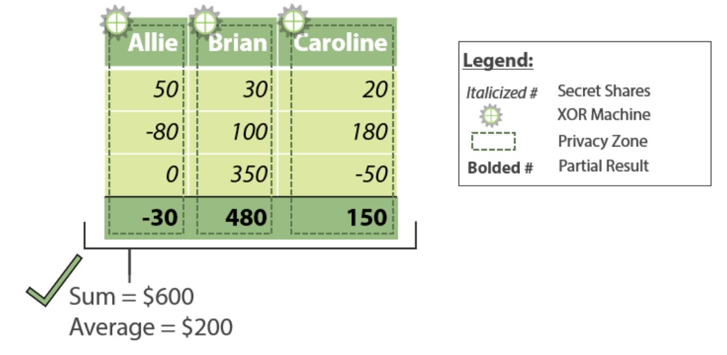
Secure Multi Party computation
Secure multiparty computation (MPC / SMPC) is a cryptographic protocol that distributes a computation across multiple parties where no individual party can see the other parties’ data.
Example of salary sharing without sharing
The goal is to calculate the average salary without sharing individual salaries

